Slide 1
CREDIT FRAUD DETECTION PROJECT
A MACHINE LEARNING APPROACH TO PREDICT LOAN DEFAULTERS

Slide 2
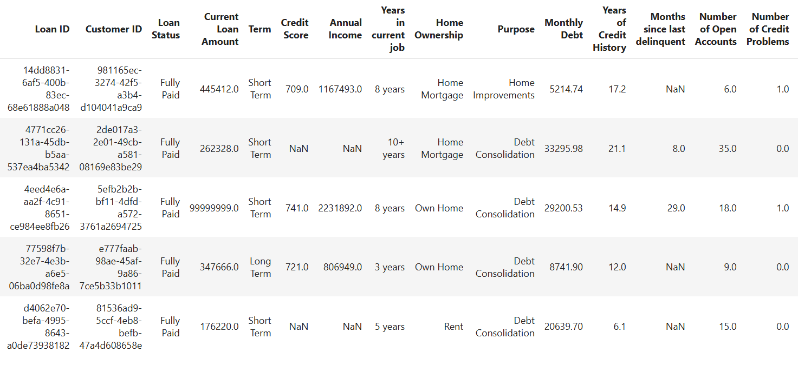
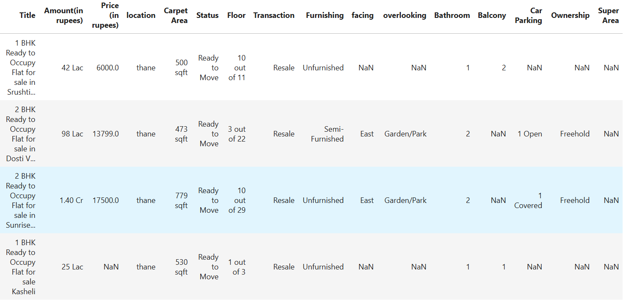


Objective
Attributes:
Loan ID, Customer ID, Loan Status, Current Loan Amount, Term,
Credit Score, Annual Income, Years in current job, Home Ownership,
Purpose, Monthly Debt, Years of Credit History, Months since last
delinquent, Number of Open Accounts, Number of Credit
Problems, Current Credit Balance, Maximum Open Credit,
Bankruptcies, Tax Liens
Dataset Size:100514 rows,21 columns
This project aims to Predict credit scores & annual income using Machine Learning Models - Linear Regression,Lasso & Ridge then using these values to predict Loan Status using KNN, Decision Trees, SVM, Random Forest
Implement Hyperparameter tuning using GridSearchCV & RandomizedSearchCV.

Slide 3
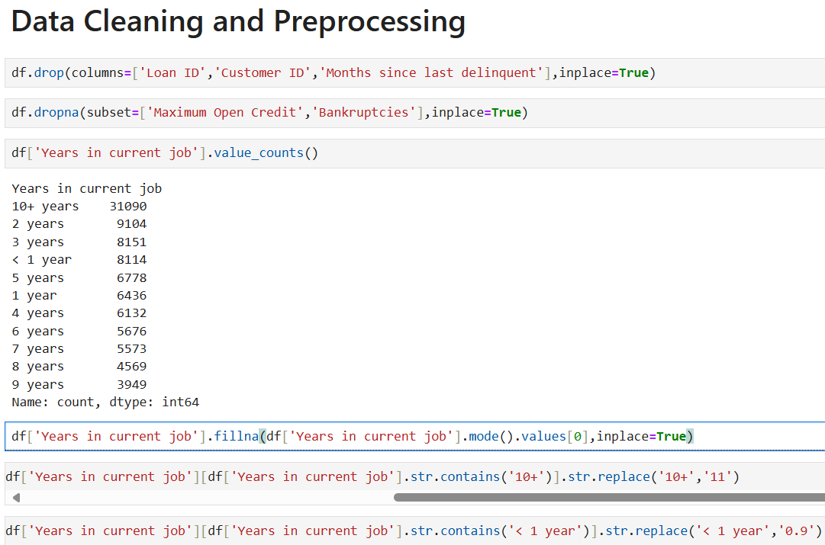
Data Cleaning and Preprocessing
Removed irrelevant columns (Loan ID, Customer ID, etc.
Handled missing values
Converted categorical data to numerical
Detected & handled outliers using the IQR method
Label-Encoded Ordinal data

Slide 4
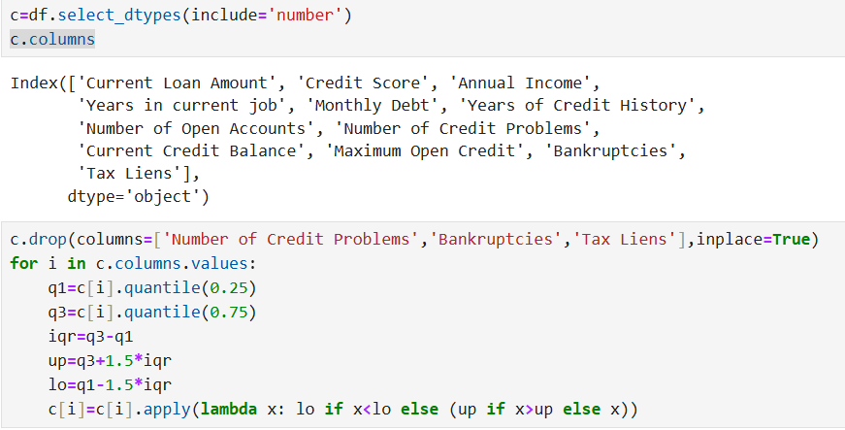
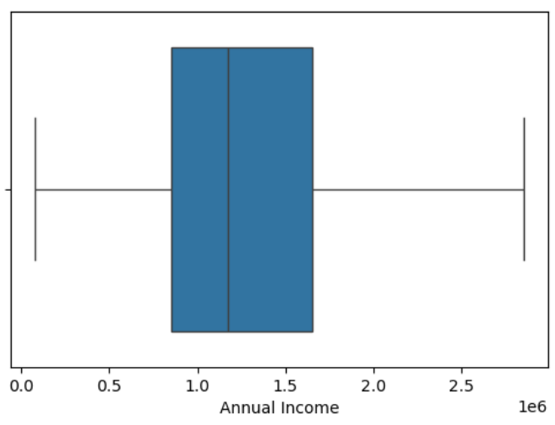
Outliers Handling

Slide 5
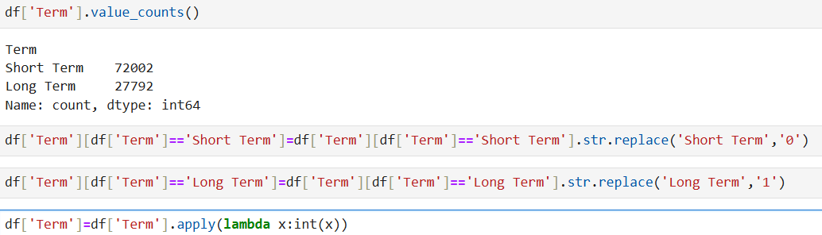
Label-Encoding

Slide 6
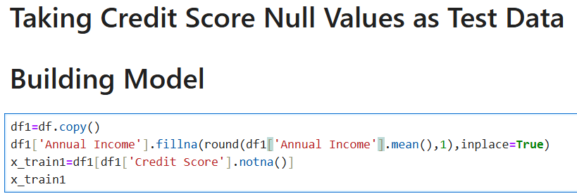




Slide 7
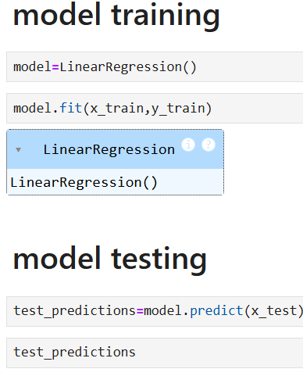
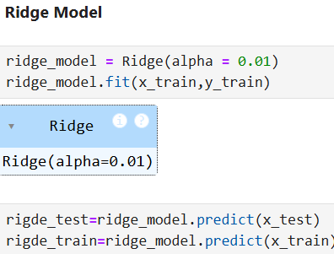
Regression Models for Credit Score and Annual Income Prediction
Applied:
Linear Regression
Ridge Regression
Lasso Regression
Evaluated these models using
Mean Squared Error (MSE)
Root Mean Squared Error (RMSE)
R- Squared Score (R²)

Slide 8
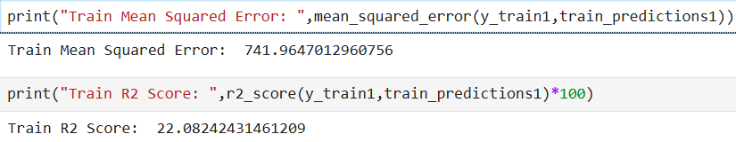
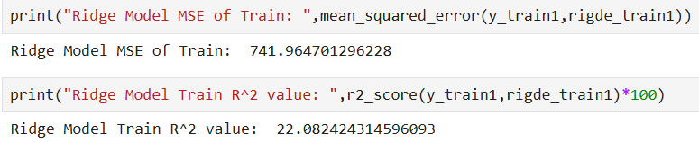
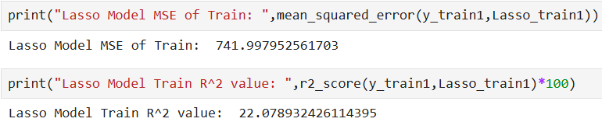
Results for Credit Score

Slide 9
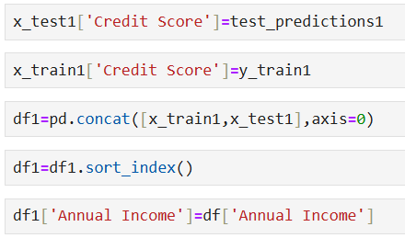
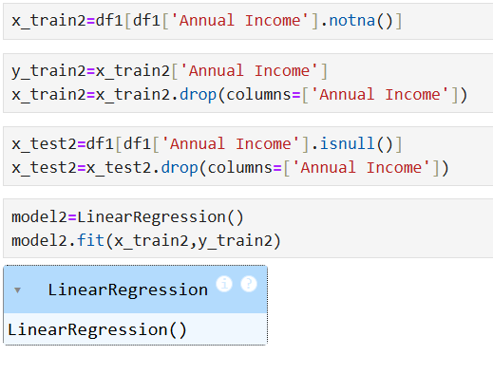
After Predicting credit score , we fill credit score with actual and predicted values and replace Annual Income with Actual Annual Income to predict

Slide 10
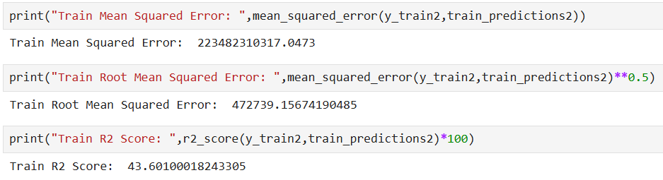
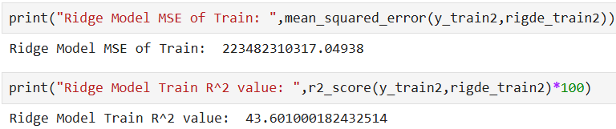
Results for Annual Income

Slide 11
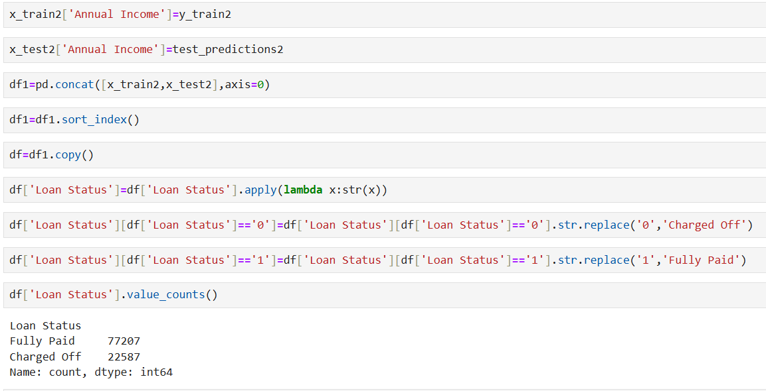
Filling Annual Income Column and changing Loan Status into Categorical column

Slide 12
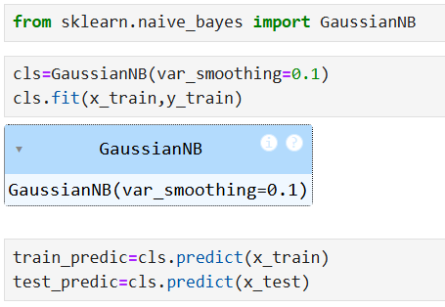
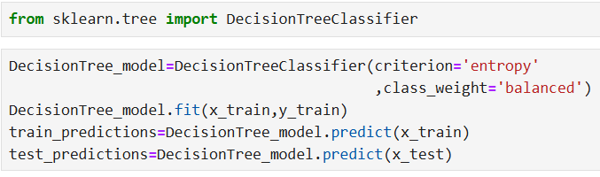
Classification Models for Loan Status Prediction
Applied:
K-Nearest Neighbors
Naïve Bayes (GaussianNB)
Decision Tree & Random Forest
Support Vector Machine (SVM)
Evaluation Metrics Used:
Confusion Matrix
Classification Report
Accuracy Score

Slide 13
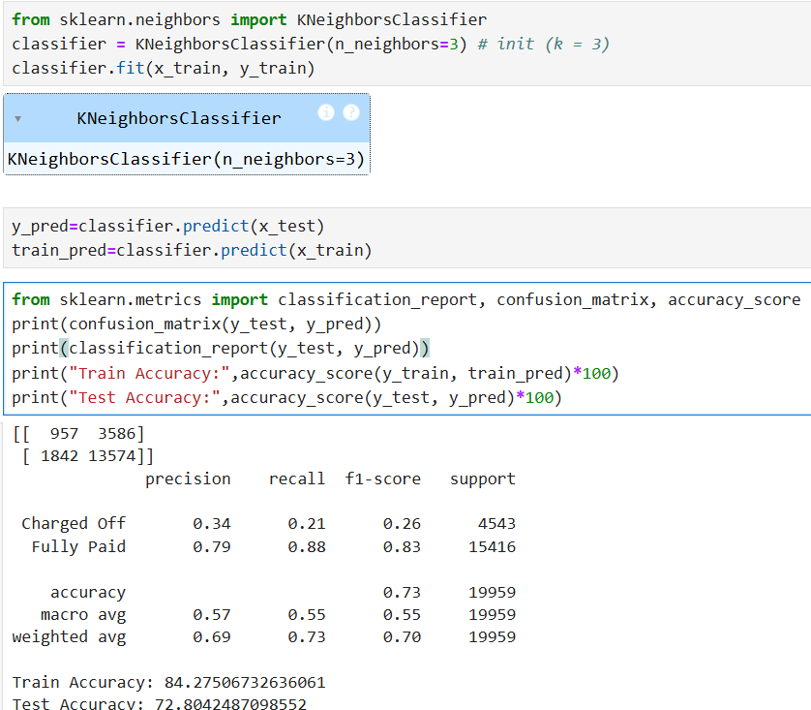
K-Nearest Neighbors

Slide 14
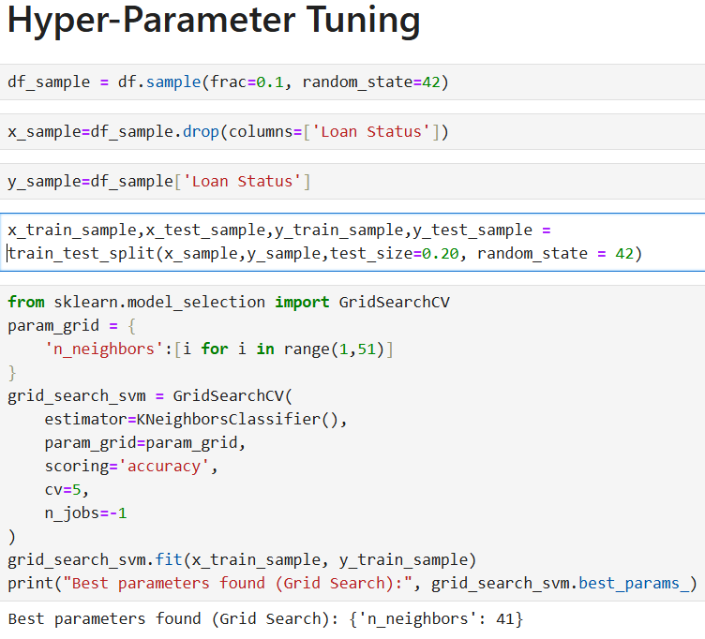
Hyper Parameter Tuning
After hyper parameter tuning using GridSearchCV , got best parameter

Slide 15
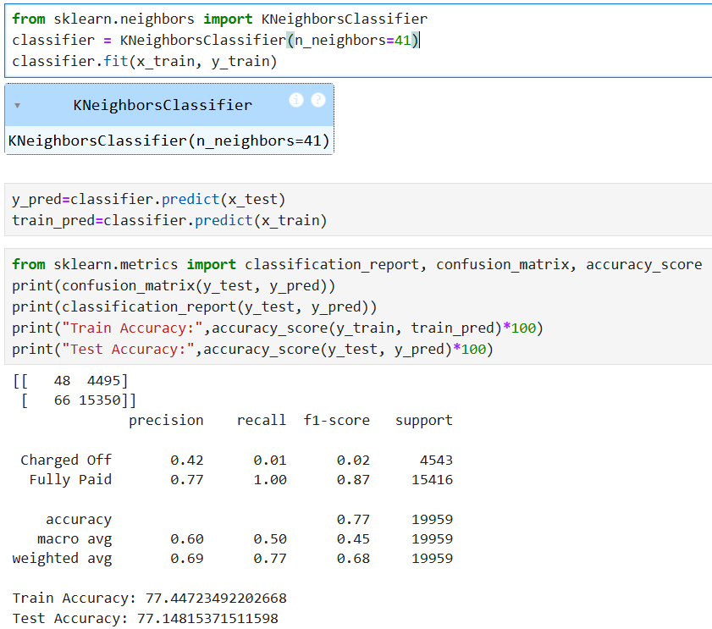
K-Nearest Neighbors Model after Hyper Parameter Tuning

Slide 16
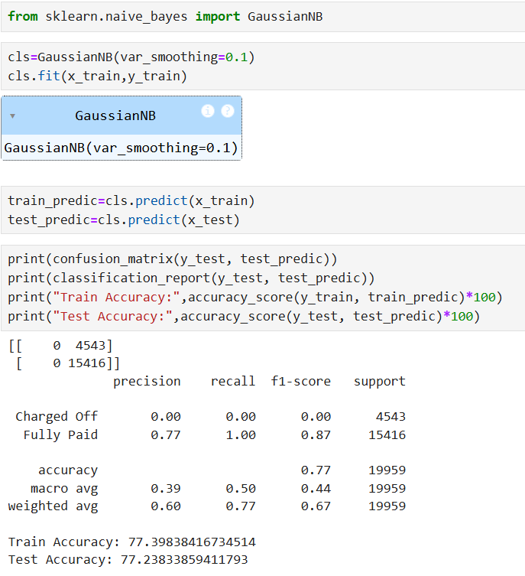
GuassianNB Model

Slide 17
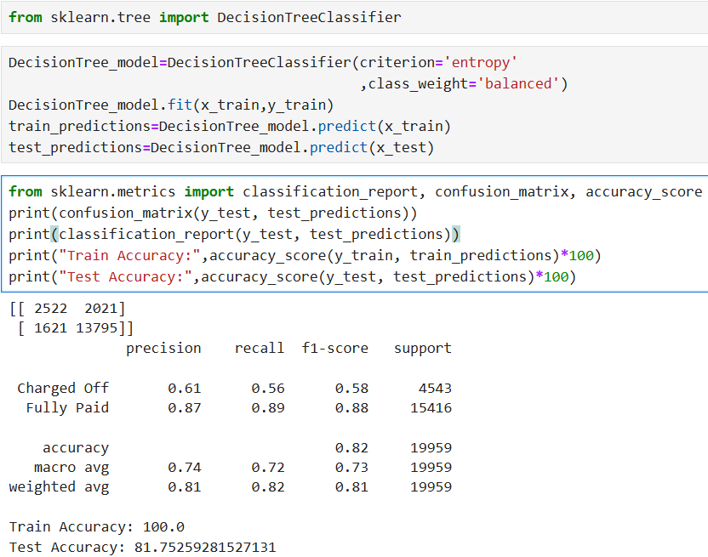
DECISION TREE

Slide 18
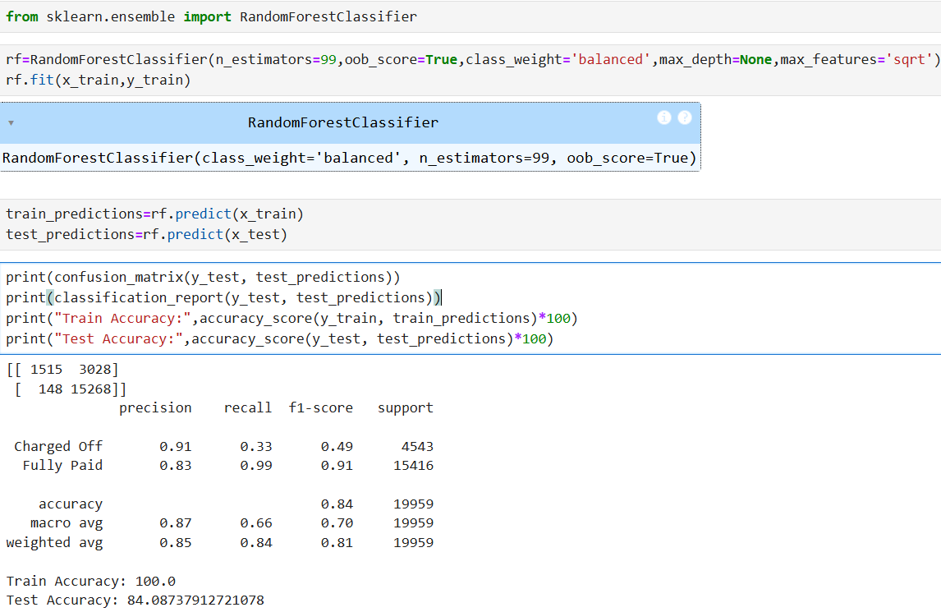
RandomForestClassifier

Slide 19
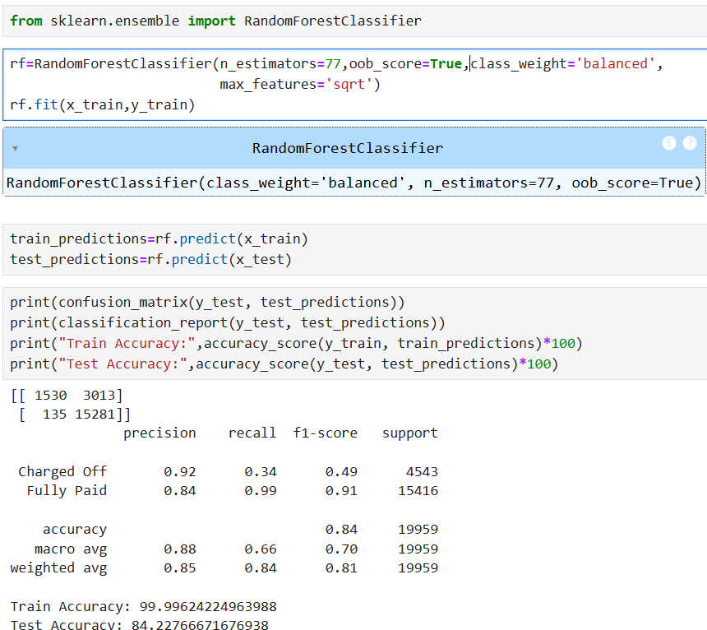
RandomForestClassifier model after Hyper Parameter Tuning

Slide 20
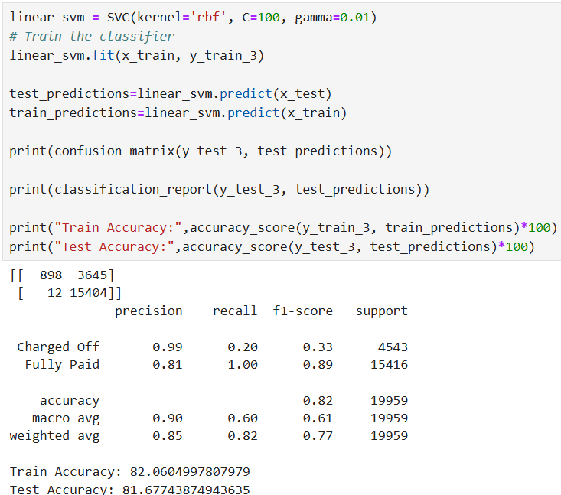
Support Vector Machine

Slide 21
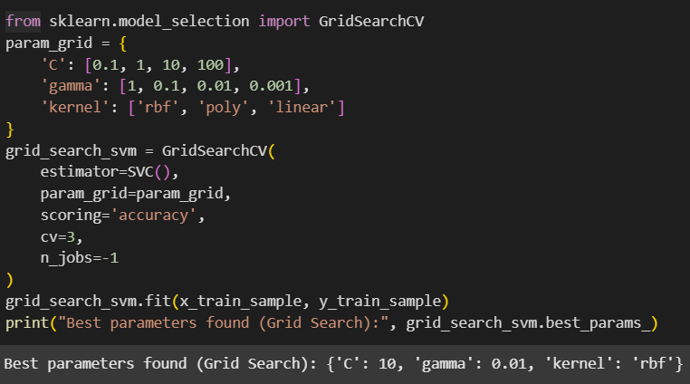
Hyper Parameter Tuning Using GridSearchCV

Slide 22
Results and Conclusion
Random Forest, SVM had the best accuracy and for detecting Loan Defaulters
GridSearchCV took long time but improved accuracy
Feature engineering & outlier removal improved performance
Hyperparameter tuning optimized models

